Slide 1
Machine Learning Capstone Project

Slide 2

STOCK PRICE PREDICTION
Using machine learning methods to predict the stock price of Google

Slide 3
Members
Dang Kieu Trinh - 20214933
Nguyen Minh Triet - 20214975 Dang Minh Duc - 20214956 Do Manh Cuong - 20214948

Slide 4
Walkthrough
I.Introduction
II.Data Exploring
III.Methodology
IV.Results
V.Conclusion and future work

Slide 5
Introduction
This capstone project focuses on leveraging machine learning techniques to predict the stock price, aiming to provide investors with valuable insights for informed decision-making.
In this presentation, we discuss the methodologies employed in developing our prediction model. We present and analyze the results obtained, comparing the performance of our model.

Slide 6
II.Data Exploring
The Dataset
Data Preprocessing
Drop unused fields
Handling missing values
Data Transformation
Feature Selection
Feature Scaling

Slide 7

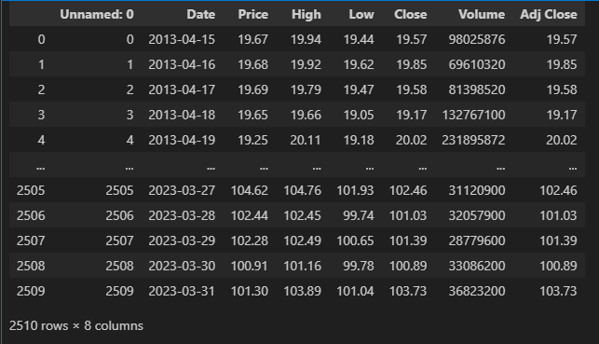
Dataset
The dataset we used is the historical price information for Google's stock, covering the period from March 2013 to the present.
The dataset consists of 7 columns which is:
Date: when the stock price was recorded.
Price: The price at which the financial security opens in the market when trading begins
High: represents the highest price at which the stock was traded during the day.
Low: The closing price of a share of Google stock on that date.
Volume: The total number of shares of Google stock that were traded on that particular trading day.
Close Adj: The adjusted closing price of a share of Google stock on that date.

Slide 8
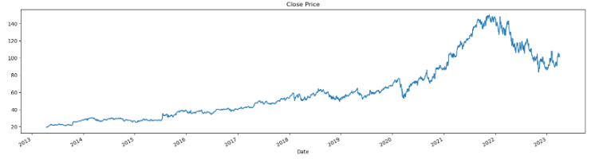
Dataset
Time Series Introduction
Time series refers to a sequence of data points collected or recorded over time at regular intervals. It represents how a variable or phenomenon changes and evolves over time.
Stock price data is a classic example of time series data. It represents the historical prices of a particular stock over time. Each data point corresponds to the price of the stock at a specific point in time

Slide 9
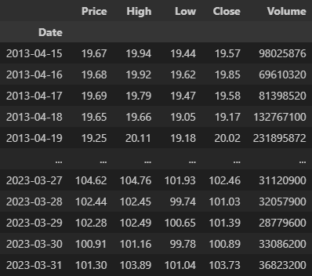
Dataset
Drop unused fields
“Unamed” represents the index of rows
“Close” and “Adj Close” are completely the same
Missing values
The dataset is complete, there is no missing values

Slide 10
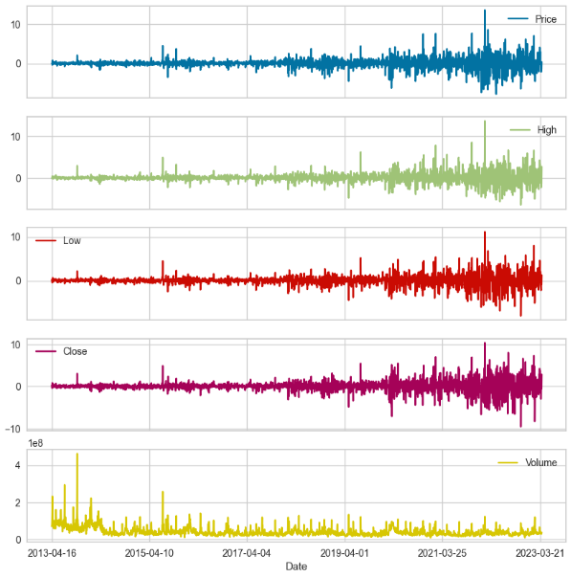
Dataset
DataTransformation
Converting non-stationary data into stationary data to work with time-series problem.
Using difference method for converting process

Slide 11
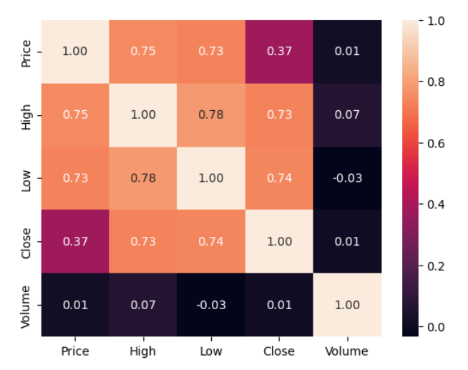
Dataset
Feature Selection
Several column pairs are highly correlated, indicating a positive correlation.
Since we have small number of features, and these columns exhibit a high correlation with the dependent feature, so we decided to keep them all for predicting purpose.

Slide 12
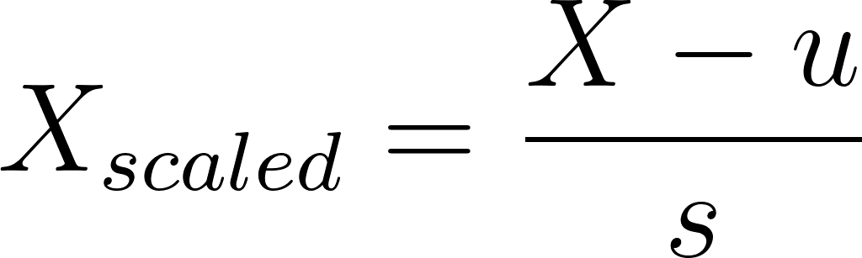
Dataset
Feature Scaling
To ensure consistency and comparability in our data analysis, we employed standardization to scale the variables
By applying standardization to the Price, Open, Low, High and Close features, we ensured that these variables were on a comparable scale, enabling fair and meaningful comparisons and analysis throughout our study.

Slide 13
Methodology

Slide 14
Time Series forecasting can be achieved through the application of time series models.
We can approach time series forecasting as a supervised learning problem, enabling the utilization of various machine learning models to predict the target variable.
In the context of this specific problem, we can reframe it as a regression problem.

Slide 15
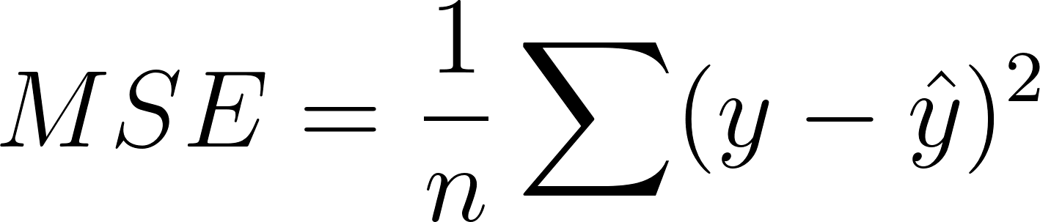
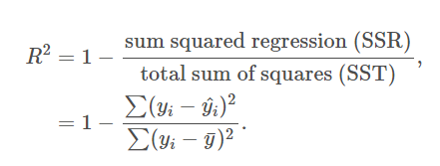
Loss functions
Mean Squared Error (MSE)
In this project, we use two evaluation methods: MSE and R-Squared.
R-squared (R2)

Slide 16
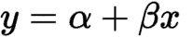
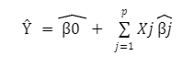
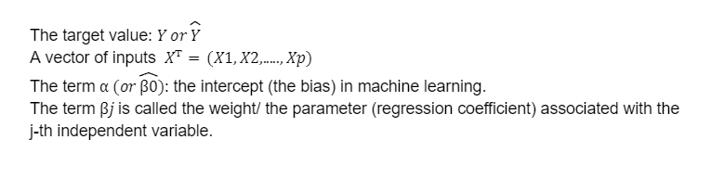
Models
Linear Regression
Simple Linear Regression:
Multiple Linear Regression
Where

Slide 17
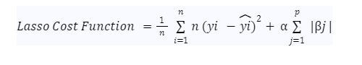
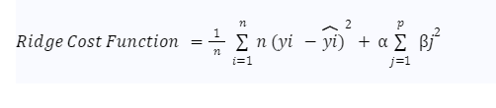
Linear Regression
Lasso Regression (L1 Regularization)
Ridge Regression (L2 Regularization)

Slide 18
Random Forest Regression
Random Forest
The random forest algorithm takes the average prediction result from the individual decision trees to predict the stock price.
In RF, we need to find some hyperparameters that optimize the model:
N_estimators: The number of decision trees being built in the forest.
Criterion: The function that is used to measure the quality of splits in a decision tree. In case of regression, MAE or MSE can be used.
Max_depth: The maximum levels allowed in a decision tree.
Min_samples_split: Decides the minimum number of samples required to split an internal node.
Min_sample_leaf: The minimum number of data point requirements in a node of decision tree.
Bootstrap: method for sampling data points (with or without replacement)

Slide 19
LSTM
LSTM or Long Short-Term Memory is an improvement over traditional RNN or Recurrent Neural Network in the sense that it can effectively “remember” a long sequence of events in the past. Just like humans can derive information from the previous context and can chart his future actions, RNN and LSTM tend to imitate the same. The difference between RNN and LSTM is that RNN is used in places where the retention of memory is short, whereas LSTM is capable of connecting events that happened way earlier and the events that followed them.
Hence, LSTM is one of the best choices when it comes to analyzing and predicting temporal dependent phenomena which span over a long period of time or multiple instances in the past.

Slide 20
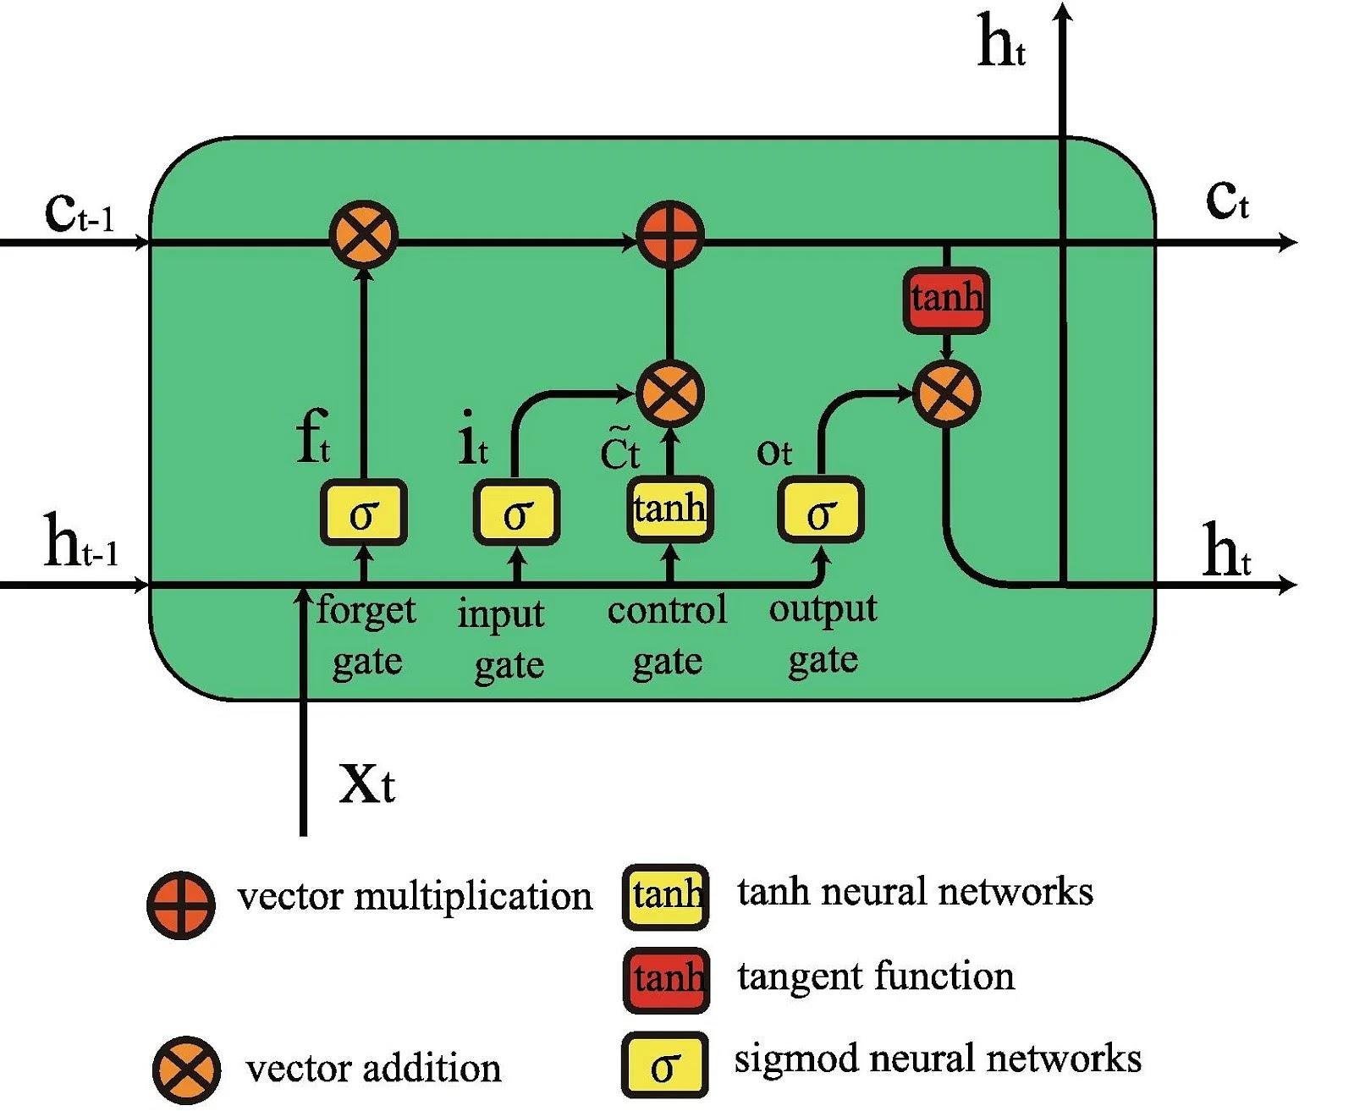
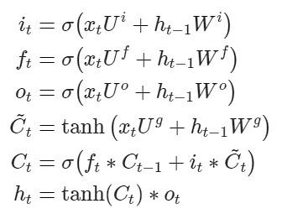
LSTM
As seen in the equations below, i, f, and o represent the three gates: input, forget, and output. C is the cell state that preserves the learned data, which is given as output h. All of this is computed for each timestamp t, considering the learned data from timestamp (t-1).

Slide 21
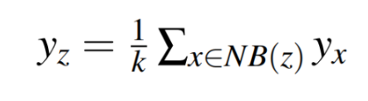
K Nearest Neighbors Regression
The prediction of stock market price is computed using kNN as follows:
Determine the number of nearest neighbors,|NB(z)| = k.
Compute the distance between the training sample and new instance z.
Sort all training records according to the distance values.
Use a majority vote for the labels z of k nearest neighbors, and assign it as a prediction value of the new instance.

Slide 22
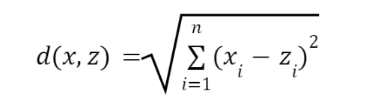
K Nearest Neighbors Regression
Parameters:
Number of neighbors (K): Determines how many nearest neighbors are considered for regression.
Distance metric: Measures the similarity between data points (e.g.,Euclidean, Manhattan, etc.)

Slide 23
K Nearest Neighbors Regression
Advantages:
Simple and easy to understand
No assumptions about the underlying data distribution
Effective for smaller datasets
Limitations:
Computationally expensive for large datasets
Requires proper selection of K value,similarity measure.
Not suitable for high-dimensional data

Slide 24
Results

Slide 25
Results
Models | Training set |  | Test set
 | MSE | R2 | MSE | R2
Linear Regression | 0.001 | 0.7316 | 0.003 | 0.7787
Random Forest | 0.099 | 0.8763 | 1.6277 | 0.7155
LSTM | 0.1311 | 0.7732 | 0.148 | 0.7179
KNN | 0.0007 | 0.7924 | 0.003 | 0.727

Slide 26
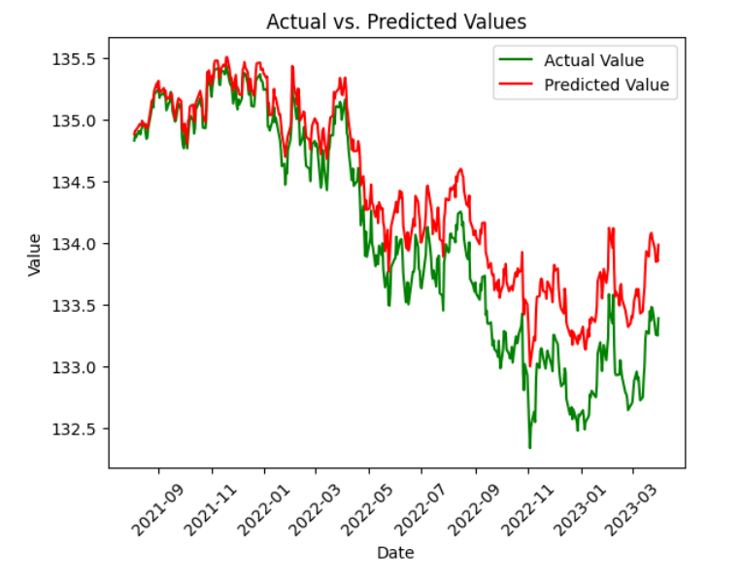
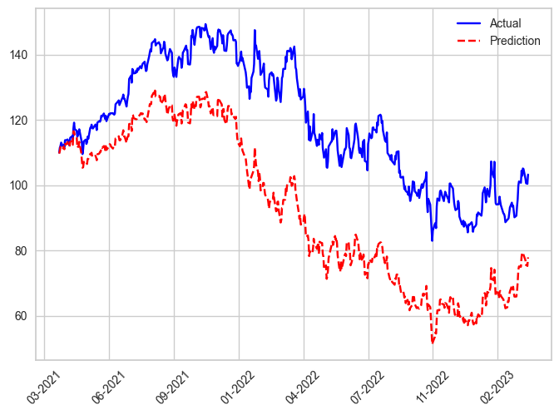
Result
Linear Regression model
Random Forest Regression

Slide 27
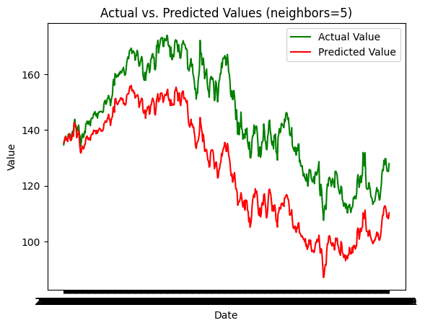
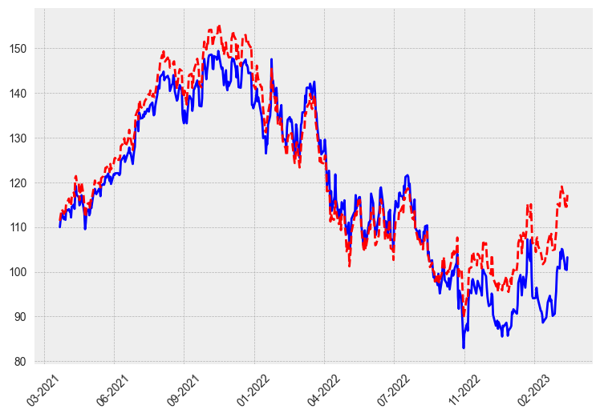
Result
KNN model
LSTM model

Slide 28
Conclusion & Future work

Slide 29
Conclusion
Model Performance: All models performed well in predicting the target variable, but based on the R2 score on the testing set, Linear Regression showed the highest accuracy.
Context of the Problem: Predicting stock prices solely based on daily information is not a realistic and practical approach for long-term or future predictions.
This project serves as an experimental endeavor rather than a practical forecasting tool for long-term stock price predictions.

Slide 30
Future work
The goal is to advance the model, exploring more sophisticated algorithms, and considering other factors that influence stock prices.
Practical Application: By enhancing the model, the aim is to transform it into a practical and valuable tool that can assist investors in making informed decisions.

Slide 31
THANK YOU !

